Slide 1

Implementing Green Technology
Government Technology Conference
January 31, 2008
Brad Dupuy
Industry Manager, State and Local Government Markets
HP Technology Solutions Group

Slide 2

The world environmental issue
Limited energy resources
Escalating costs
Business disruption from limited power
Global environmental impact
Social accountability
Notes:
The environmental issues facing our planet have received a tremendous amount of visibility recently. Everyone is becoming acutely aware that the planet only has a limited amount of resources and those resources need to be conserved.
Compounding the problem is the fact that the cost for those natural resources are sky-rocketing (going up rapidly). During this presentation, we’ll show you exactly why the cost for energy is going up so dramatically.
Of course, there is an environmental impact on our planet when we consume resources too quickly. Our ever-increasing use of non-renewable resources leaves little hope for generations that will follow us in the years ahead. And, consuming resources irresponsibly put more carbon into our atmosphere than our planet can sustain.
Together we carry a big responsibility to be care-takers of our planet. The good news is: HP has the solutions to help address the problem. Throughout this presentation, we’ll describe to you what HP is doing and what you can do to reduce your energy cost, help conserve resources, and reduce your carbon footprint.

Slide 3

Environmental Sustainability and Obtainable Goals
Understanding Government Impact
Federal Mandates
Goals and Initiatives in other states
What state CIOs are saying
Collateral benefits of Green IT
Together Government and Private Sector can set realistic Green IT Goals

Slide 4
The Energy Problem
Fuels used to generate electricity
Natural gas prices
increased 300% since 1999
Coal spot market prices increased 100% since 2003
Oil prices for electric generators increased 50% from 2003 to 2005
Nuclear uranium prices increased 40% since 2001
Oil
Other
Hydro
Nuclear
Natural Gas
Coal
Concurrent with increasing electricity costs, server energy demand doubled from 2000 to 2005*
In the USA, data centers used 61 billion kilowatt-hours (kWh) in 2006, or 1.5 percent of total U.S. electricity consumption according to the DOE
*Lawrence Berkley Labs & Stanford, Feb 2007
Source: Edison Electric Institute, September 2006
Notes:
Why are energy costs going up so dramatically?
Through basic supply and demand economics, we understand that as demand increases and supply decreases, prices tend to rise. And this is exactly what is happening. At the same time Data Centers demand more electricity, the supply of electricity is constrained.
In the Americas for example, demand for electricity has doubled from 200 to 2005, to the point where Data Centers now consume 1.5% of all electricity in the country.
Compounding the demand for energy is the cost for producing energy has gone up. Four of the main natural resources for producing electricity have seen sharp cost increases. Even countries like France, which get more than have of their electricity from Nuclear have seen price increases.
Coal prices have doubled, Natural Gas prices have quadrupled and even oil & uranium have gone up substantially.
And, the situation doesn’t appear to be getting any better.
In August of 2007 we saw the highest prices in years for crude oil at close to $80 per barrel.
With no end in sight to increasing energy costs, we have no choice left but to conserve and reduce our insatiable demand.

Slide 5

The eWaste Problem
While Electronic waste represents 2 percent of America's trash in landfills, it equals 70 percent of overall toxic waste (1)
In the US – 65 Million computers to be retired this year (2)
Switzerland was the first electronic waste recycling system 1991 beginning with collection of old refrigerators. Now recycles approx. 20 lbs per capita
Europe, the Waste Electrical & Electronic Equipment (WEEE) will continue to have strict guidelines for recycling electronics.
Mandates include Congress law 109-431 ordering EPA to study environmental issues and technology
(1) Slade, Giles. "iWaste", Mother Jones, 2007-04-01. (2) http://ecycleenvironmental.com/
Notes:
Regulatory agencies have also gotten involved on a Global Basis.
In the Americas, Congress passed public law 109-431 ordering the Environmental Protection Agency to study energy consumption in data centers. Hp contributed extensively to this study and the report has been sent back to the US congress. Additionally, we believe that in 2009, we will see the US require an “Energy Star” type rating for server products.
In Europe, the Waste Electrical & Electronic Equipment (WEEE) will continue to have strict guidelines for recycling electronics. Additionally in Europe, there will be more RoHS supplemental requirements for the reduction of hazardous substances.
In March of 2007, China activated 27 articles to reduce and control pollution to the environment. The State Environmental Protection Administration and multiple other government entities jointly agreed to all 27 articles in an effort to curb pollution in China
In general, the environment is a Global issue effecting every company in any country in the world.

Slide 6
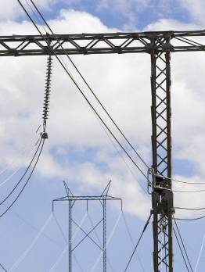
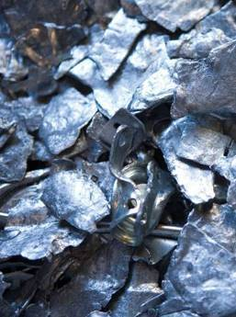
Mega Considerations for Green IT
Energy Efficiency
ENERGY EFFICIENCY
Material Impact

Slide 7
Mega Considerations for Green IT
Energy Efficiency
ENERGY EFFICIENCY
Material Impact

Slide 8

Energy Efficiency
Energy Consumption from IT products
Data Center considerations
IT Strategies, such as Virtualization
Current Energy Standards on IT

Slide 9

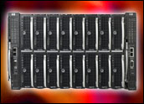
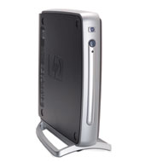
Energy consumption of the products
Power
Evolution
Cooling
Evolution
Individual product advances
Power/ Watts
Density
Dual/Quad core
Green chips
Thermal Logic sensors
Power balancing
Active cool fans
Local/Central cooling controls
80+ Power Supplies
Thin Client
Increased Notebook and Flat Panel use

Slide 10
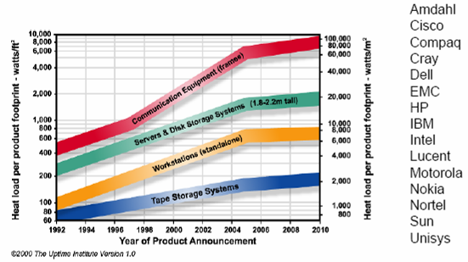
What the industry predicted ….
Systems power rising ….

Slide 11
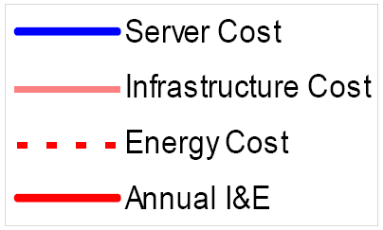
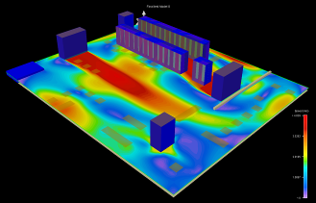
First, let me appeal to your pocketbook
Conflict between scaling IT and energy efficiency
Data centers are at a breaking point
Data center power density up >5x in the last 10 years
I&E Costs are 2X that of a 1U server today (more tomorrow)
Energy costs are rising and make things worse
It takes as much power to cool as to compute
Source: Belady, C., “In the Data Center, Power and Cooling Costs More than IT Equipment it Supports”, Electronics Cooling Magazine (Feb 2007)
IT & cooling power & electricity cost of $0.1/kW-hr
Notes:
Fix lables, add trend, add 100 w/ft2
Operational spend is outstripping acquisition costs

Slide 12
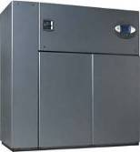



Data center energy requirements— an idea of the scale of things
60 W
500 W
12 KW
+
10 - 15 KW
1 MW
Calculate your energy consumption
EXAMPLE: 1 rack filled with 24, 4P servers uses 12KW
100 Racks @ power- 12 KW + cooling- 12 KW = 2,400 KW,
Cost: @ 0.15 KWHr. = $3M per year (8,760 Hrs)
Total consumption is 20MWHrs
Note: power/cooling energy depends on applications, workloads, environment, climate, energy costs, etc…. All assumptions are provided as an example only
Notes:
EXAMPLE: 1 rack filled with 24, 4P servers uses 12KW
100 Racks @ 12 KWHr = 1,200 KWHrs, 1,200 KWHr power + 1,200 KWHr cooling @ $0.15 per KWHr = $360 / Hr x 8760hrs = $3M
Total power is 2,400 KWHrs x 8760 Hrs=20MWHrs)*

Slide 13


And it’s not just dollars and cents
Coal is used to generate approx. 50% of US energy
1 lb of coal produces approx. 1.4 KWHr*
20 lbs powers and cools a server for about 1 hour
US impact numbers:
  US Data Center use: approx 61 Billion KWHrs Energy
  Use equates to 84 MegaTons of Coal per year
  Or over two million –
  “40 ton” dump trucks
Notes:
*DOE estimate
1 ton equals 2,000 lbs or 2,800 KWhrs or 2.8 MWhrs
300 MW/hr = 2.6 Million MWHrs in a calendar year
2.6 mill / 2.8 = 929,000 tons
61,000,000,000

Slide 14
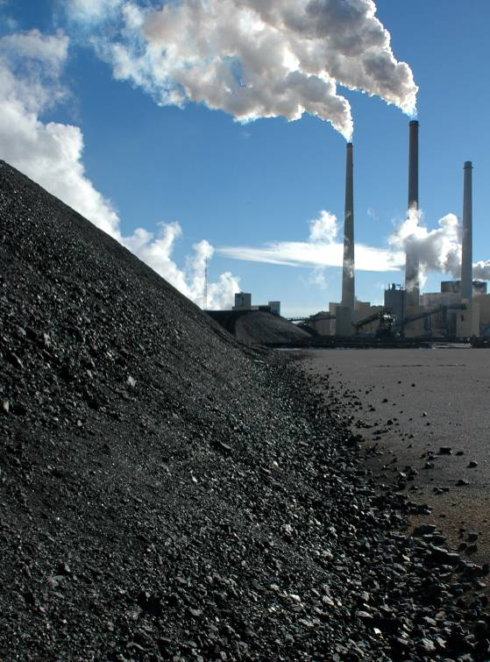
The global carbon footprint
If the world used power saving solutions
  The world’s data centers could save over $2 billion/yr in US currency equivalents¹⁵
  American data centers could cut carbon emissions up to 1 million tons each year¹⁶
    Equivalent to taking 1 million autos off the road every year
  Asia could curb its growing need for energy
    China now emits more carbon into the atmosphere than any other country¹⁷
    By 2010 Asia will be the largest consumer of primary energy¹⁸
    By 2020 China & India will produce more carbon emissions than the USA & Europe combined¹⁹
Notes:
Of course, along with saving money, you can also help save the planet.
There are some suprising facts on this slide, so take time to point them out to your audience
Check slide 29 for detailed documentation on the calculations and references
The important thing to emphasize is that customers can save money, but also feel good about preserving the environment
And, everyone can do their part.

Slide 15
Designing a Smart Data Center
Delivering demand-based provisioning of compute & energy resources
Pillars of the Data center: Compute, Power and Cooling
Goal: Improve data center energy and operational efficiencies
Holistic design of flexible energy-aware management/provisioning solutions
End to end focus from chips to room
Comprehending products & services
Compute
Power
Cooling
Control Engines, Tools
Sensing Infrastructure
Flexible & Configurable Elements

Slide 16


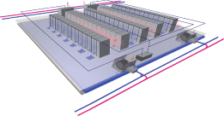

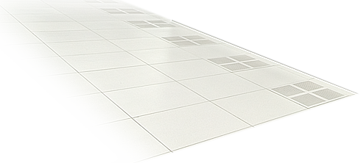
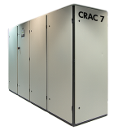


Evaluating energy efficient solutions for the IT Power & Cooling Chain
Energy Savings
Overall Strategies
Thermal Zone Mapping, Data Center Assessments, Data Center Site Preparation
Up to 33% of Entire Data Center Power
Data Center & Facilities
Dynamic Smart Cooling
Modular Cooling System
Power Distribution Rack
Three Phase UPS
Optimizing from chip to chiller
Manageability Tools
Insight Power Manager and iLO 2
Dynamic Capacity Management
Thin Provisioning & Data de-duplication
Virtualization
Systems
BladeSystem Enclosures
Thermal Logic
PARSEC enclosure cooling
Active Cool Fans
Servers & Storage
Efficient Power Supplies
Energy Optimized Servers
Small Form Factor Drives
Low Power Processors
Low Power Memory
“Chip to Chiller”
Notes:
On this slide, it is important to explain the HP “Chip to Chiller” concept. That is; HP has a holistic and comprehensive strategy that addresses all the power conservation opportunities from the small processor chips inside the server, through the servers and BladeSystem products, out to the data center solutions like our EIS products, and finally the large data center air chillers themselves. Unlike our competition that offer point products that reduce energy consumption, HP has a myriad of solutions all working together across the data center value chain to reduce power consumption at every level.
Starting with the lower left corner of the slide, HP deploys low power processors inside our servers that help reduce energy consumption. Research we’ve done (power calculator) indicates the processors account for about 30% of the electricity needed to power a server. By using a 50 watt processor in lieu of a 100 watt processor, HP can save customers 15% (30% x 50%) of the electricity typically needed to run a server.
Power Supplies available soon from HP are capable of operating above 90% efficiency at high server utilization. Virtualization reinforces this capability by loading individual servers up to higher utilization rates, thus running the power supply more efficiently.
HP has standardized on Small Form Factor 2.5” drives in all of our enterprise level servers. While some of our competition offers the bigger 3.5” drives, HP benefits from the smaller drives because they consume half the power. Reducing the power consumption on every drive from 18 watts down to 9 watts can be substantial for customers that have large rotating storage media requirements.
Power Optimized ProLiant Servers take advantage of the previous 3 components and add power manageability software on the 7 models HP offers. Currently, HP offers these power optimized servers through our configure to order system to customers around the world. According to the HP power calculator, customers can save about 18% on the power required to run a similarly configured “non-energy-optimized” server. In the future, HP plans to launch BTO server models that will be power optimized and include low power memory to increase customer savings.
HP BladeSystem provides a large opportunity for energy savings. IDC recently conducted a side by side comparison of a C class BladeSystem with and equivalent processing configuration of a set of rack mount servers. According to the IDC white paper published publicly, the BladeSystem used 25% less energy & floor space than the rack mount system. The BladeSystem delivers this huge amount of savings through its PARSEC (parallel redundant scalable enclosure cooling) architecture, its revolutionary active cool fans, Dynamic power saver that makes power supplies operate at higher efficiency levels , and its power regulator capability that reduces power consumption of the processors.
Power Distribution Racks, Modular Cooling Systems, and High Airflow HP Racks provide additional opportunities for power efficiency. According to the Gartner Group, any rack cabinet using 25kw or more should be liquid cooled. The HP MCS solution provides customers the opportunity to use liquid cooling in data centers without mixing water inside the servers themselves. Additionally, the HP PDR delivers power closer to the server cabinets, therefore reducing energy loss through long cable lines and improving airflow that might be restricted due to under-floor power cable clutter.
Insight Power Regulator and iLO 2 provide customers even greater energy saving opportunities through power monitoring features, power capping capabilities, and regulating ability. Power Regulator comes free with our ProLiant servers and can save customers up to 10% on power consumption in servers. Power capping allows customers to put 40% more servers in the same “power envelope”. Monitoring & measuring gives visibility to precisely how much energy is being utilized, as apposed to using the “name plate rating” on the chassis.
Virtualization & Server Consolidation can save customers up to 70% just on the power required to run servers and between 30% & 40% of the entire power required for a data center (since fewer servers need less power for cooling). It works like this: take 4 servers operating at 20% and consolidate those to 1 server operating at 80%. Now, admittedly the processors in that 1 server are more productive & need more energy, but the processors are only 30% of the server electricity draw. So the increase in utilization to 80% only impacts the 30% of power which runs the processors. The total server power consumption increases by only 18% (60% increase x 30% allocated to processors). The original power draw from 4 servers is now only 1.18 server equivalent units—a 70% savings (1.18 virtualized server/4 original servers) - 1 = 70% savings. The virtualized server leverages the same rotating hard drives, mother board, IO slots, memory, fans, and power supplies which account for 70% of the remaining power needed in a server. As a real world example, according to an article in Computerworld by Robert Scheier on September 3, 2007, Microsoft expects to save between 30% and 40% of the power needed to run their entire data center, thanks to virtualization. And, by the way; BCS has “virtual server environment” (VSE) that allows their servers to achieve the same amount of savings.
In June 2007 HP announced Green Storage that provides up to 45% savings on the power and cooling costs for large storage products. With Thin Provisioning, you want a 2TB file system, but only allocate 1TB of physical space. The file system believes it has the full 2TB to work with. Or maybe you want 10 different 2TB file systems (20TB total) and only allocate 10TB for all of them. What happens when you need some more space? Some implementations let you "borrow" space from another location. But, the obvious answer is to grow the physical LUNs (or add a new one) to provide the required space. Dynamic Capacity Manager works with Microsoft operating system to automatically migrate storage capacity to applications where it’s needed.
HP Services and in particular Thermal Zone mapping is unique to HP. It works by creating a 3 dimensional model of how much, how often, and exactly where air conditioners are blasting systems with cold air. The model helps data center managers arrange systems and resources to optimize use of pricy air conditioning. It is a static model however, and does not dynamically change air-conditioning with the addition of new storage or server equipment.
To Dynamically change the air-conditioning in data centers customers need the HP Dynamic Smart Cooling. DSC works by spinning up and slowing down computer room air conditioning units (CRACs) to meet changing heat loads—automatically provisioning cooling capacity to match demand. Coupled with Thermal Assessments, the savings on cooling costs can be as much as 45%.
It is important to point out that customers may want to add all the savings quantified in the green boxes to get some 343% power savings—which is clearly not the case. In fact, all the solutions listed work together and impact each-other to some degree. Deploying DSC for example may require the HP BladeSystem active cool fans to rotate faster to circulate more of the warmer air inside the data center. However, if customers combine the top 4 solutions (DSC, Mapping, Storage Consolidation, & Server Virtualization) the energy savings can be up to 60%. Important caveat is that all data centers are different and every customer will experience different savings. But, theoretically HP can help customers cut their data center energy costs in half—or more.

Slide 17
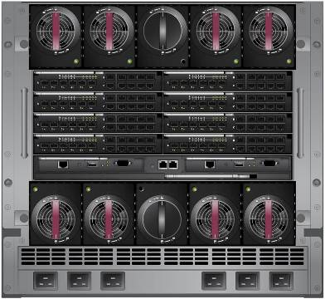
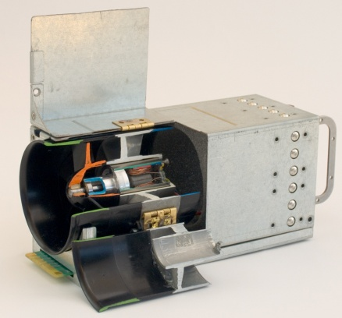
Energy-saving Blade Servers
Optimizing from chip to chiller
Conversion
BladeSystem reduces Power, Cooling, costs by 36%.*
Powering IT
Powering IT
Savings
Cooling
IT
Cooling
IT
Savings
Power Supply
BladeSystem with Thermal Logic
  Revolutionary Active Cool Fans
  PARSEC Architecture (parallel redundant enclosure cooling)
  Dynamic Power Saver
  Power Regulator
*Sine Nomine Associates Feb 15, 2007
Notes:
HP BladeSystems have several advantages thanks to Thermal Logic
According to the White paper that IDC published, Blades can provide a 25% reduction
This comes out of both costs to power the blades and the costs to cool the blades.
The white paper is available on our HP.com web site.

Slide 18
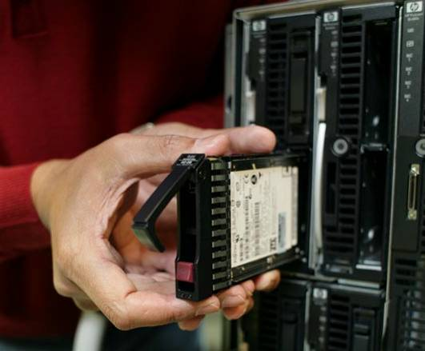
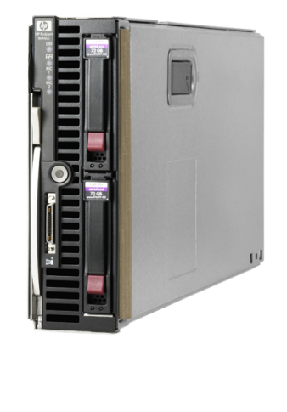
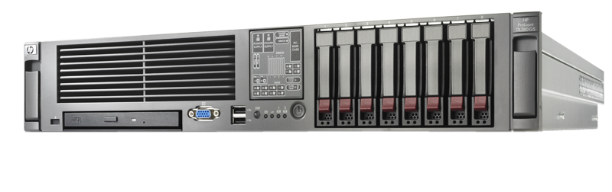
Energy-optimized Servers
Optimizing from chip to chiller
Energy Optimized servers use 15% less power.¹¹
Conversion
Powering IT
Savings
Cooling
IT
    SFF 10k 72GB hard drives
    Low Power AMD & Intel Processors
    Efficient Power Supply
    Power Manager
Notes:
Just this summer, on July 25th, we activate the WEB site to purchase Energy Optimized servers
It’s important to point out that we believe ALL of our servers are energy efficient
However, the 7 models listed on this slide are energy “optimized” to further reduce customer’s power consumption
According to our internal power calculator, the energy optimized server consumes 18% less power
We compared a DL380g5 to an energy optimized DL380g5 with the same number of drives, fans, and memory dimms.

Slide 19
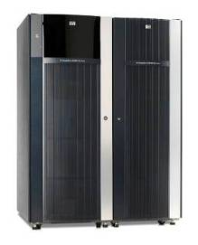
Green Solutions and Data Storage
Thin Provisioning (XP24000)
Reduce cost and save power by up to 40% ¹ – customer only buys what it needs today
Automatically allocates physical capacity
EVA Dynamic Capacity Management:
Virtualization for Storage
Improves disk utilization improves power efficiency
Raises capacity utilization efficiency by up to 2X
Saves up to 45% on power
Conversion
Powering IT
Savings
Cooling
IT
¹ Actual savings will vary depending on starting capacity, HDD type, and several other factors
Notes:
The XP20000 Disk Array - The XP20000 is the latest member in the XP family of enterprise disk arrays. It is an entry-level enterprise, 240 disk drive, 69 TB capacity storage device designed to provide constant data availability and unfailing protection, along with efficient data management solutions, to mission critical environments.
Thin Provisioning - HP StorageWorks XP Thin Provisioning Software allows you to reduce costs, accelerate your return on investment, and reduce the environmental impact of your XP24000/XP20000 Disk Array by supplying disk storage capacity to your applications from a pool of virtualized storage and by automatically allocating physical capacity as needed. Configure all of the capacity you will need for your XP24000/XP20000 in the future, but only buy the capacity you need today.
300 GB 15K FC Disk Drive – The XP24000/XP20000/XP12000/XP10000 disk arrays now support a higher performing 300 GB disk drive. This drive offers improved performance at a lower price point per gigabyte.
Customers can reduce cost and save power by configuring all the capacity they will need in the future, but only buying what they need today
XP Thin Provisioning automatically allocates physical capacity as it is needed from a single capacity pool
Assumptions
Ave XP config of 40TB, built with 73GB HDD
Assume use Thin Provisioning to save 50% of initial disk purchase (only purchase 20TB physical HDD)
Max savings with 73GB 15K HDD, power savings lower with 146GB HDD
Use average power cost of $.0928/KWH, cooling factor of 1.4
Acquisition cost savings do not include cost of Thin Provisioning license, or savings on Software license cost for titles licensed on raw capacity (Array Mgr, etc)
Thin Provisioning is an over-provisioning scenario. That is, you want a 2TB file system, but only allocate 1TB of physical space. The file system believes it has the full 2TB to work with. Or maybe you want 10 different 2TB file systems (20TB total) and only alloace 10TB for all of them. What happens when you need some more space? It depends. Some implementations let you "borrow" space from another location. The obvious answer is to grow the physical LUNs (or add a new one) to provide the required space.
Dynamic Capacity manager actually works with the Microsoft (only) operating system to automatically migrate storage capacity where it’s needed.

Slide 20
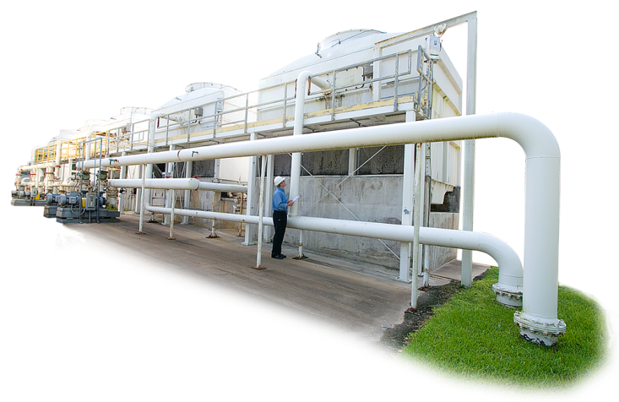
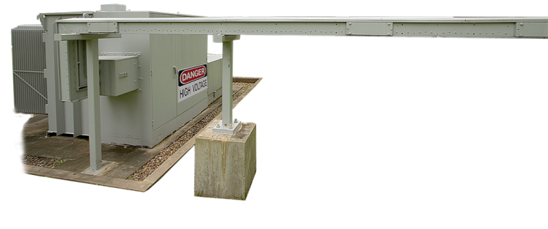
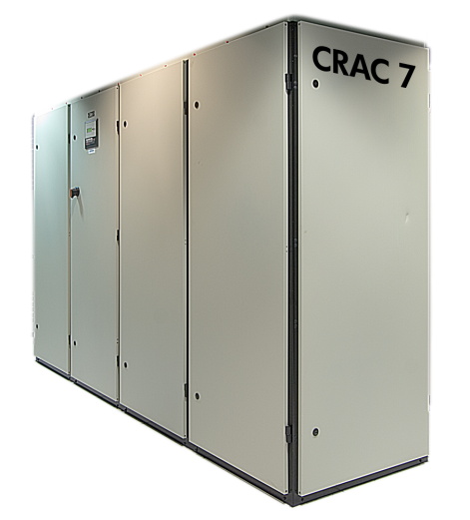

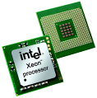

Considering a holistic energy efficient solution
Optimizing from chip to chiller (performance/watt)
Conversion
Powering IT
63% of data center energy consumption is for cooling¹
Cooling IT
Energy saving solutions from the server chip to the data center air chillers and everything in between
Notes:
Important to explain Chip to Chiller logic and meaning—especially for international locations!! This is the first slide we discuss this concept
Chillers are used to cool water and air. Think of them as large air-conditioning units. In the top left you can see a Cooling Tower with a person (me) in the foreground, which gives you an idea of how large the towers are. Water moves through these white pipes and into Chillers that cool Data Centers. Chilled water circulates through the Computer Room Air Conditioner (CRAC), which blows chilled air into your data center.
HP has solutions that we will show you that are so broad that they cover every point from the smallest computer chip inside our servers to the large Air Conditioning units.
According to the Uptime Institute 63% of energy to power a typical data center is needed to cool the IT equipment
Of the 35% of power that is used to run IT equipment; servers account for about half or 15% of the whole pie. Storage is another 40% and the remainder is networking. The source for this data is the May 21st 2007 article in NetworkWorld titled, “Green Storage Means Money Saved on Power”. Notice that all the facts have a foot-note that is documented on slide 29.

Slide 21
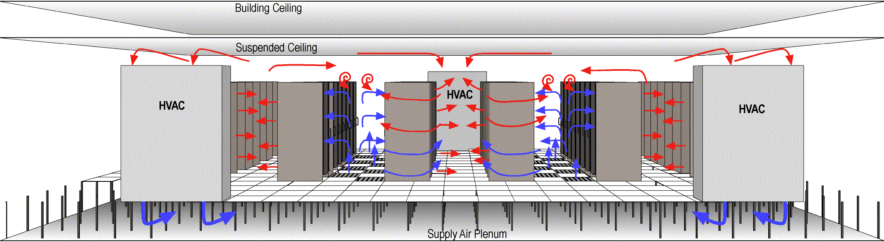
Best practice: Data Center Airflow
  Best practices
  Hot aisle/cold aisle
  Matching server airflows
  Eliminate gaps in rows
  Use longer rows
  Use cabinet blanking panels
  Orient AC units perpendicular to hot aisles
  Seal cable cutouts
  Use 0.8m to 1.0m high floors
  Use high and low density areas
  ITSM
40-50% of the inefficiency inside datacenter is linked to lack of best practices deployment
Benefits
Lower server temperatures
Better reliability
Better uptime
Extends life of current data center
Maximize server density
Lower energy usage
Lower TCO
Notes:
Pick one or two examples & elaborate.
However, best practices can only take you so far, for 2 reasons:
-1, each DC is unique and has its own constraints in terms of room shape, under floor piping etc that are very costly/impossible to change. You simply need to live within these parameters.
-2, the movement of air around the DC is far from intuitive and is very difficult to predict. A simple example is shown on the next slide.

Slide 22
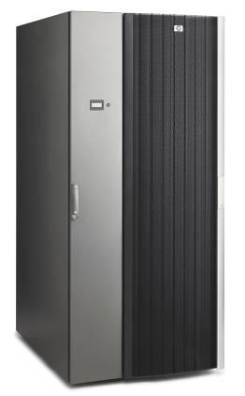
Solving hot spot issues with water cooled racks
For rack cabinets using over 15 KW, consider liquid cooled.⁵
More effective use of data center space
Cooling for high density deployments
35KW of cooling capacity in a single rack
CTO capable, up to 2000 lbs of IT equipment
Uniform air flow across the front of the servers
Cools 4 Blade chassis with 64 blades or 42 1U servers
Adjustable temperature set point
Conversion
Powering IT
15% Savings
Cooling
IT
Does not add significant heat load to data center
Server/Blade deployment unaffected by design
Level 2 Integration with Software tools
Notes:
Now we move into the data center along our journey from “Chip to Chiller” or more accurately from Chiller to Chip since we are getting closer to the smaller solutions.
Gartner Inc. was publicly quoted Data Center News as saying, “any server rack using over 25 killowatts should be liquid cooled”. By the laws of thermodynamics, we know liquid is a much better medium to transfer heat away from servers—or any thing else. Our Modular Cooling System (MCS) uses Chilled water from the building to dissipate heat out of the rack. The rack is fully enclosed and cold air is circulated in front of the servers. NO liquid actually goes into the servers themselves.
Although we cannot quantify exactly how much saving can be attributed to the MCS, we do know that it is more efficient than using over-provisioned air flow.
Also, in a data center where the air-conditioning is already at full capacity, the MCS may provide an option to cool servers without adding additional Computer Room Air Conditioning Units.

Slide 23
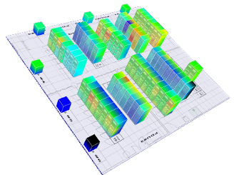
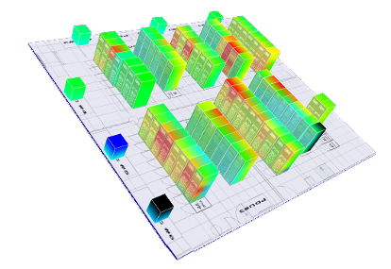
Dynamic Smart Cooling
Bridging the gap between IT & facility
Conversion
15% to 40% Reduction in Cooling Costs.³
Powering IT
Savings
Cooling
IT
Conventional Mode
Over Provisioned
Dynamic Smart Cooling Mode
Right-Provisioned
Notes:
The important items to show on this slide are the respective floor lay-outs for a typical data center and one that is “right-provisioned
Point out how all the racks in the Conventional mode are blue—which means they have too much air conditioning
See the DSC mode with more yellow and almost red racks—that shows less air-conditioning being applied since it’s not needed.
Bottom-line is: too much energy wasted providing too much cold air throughout data centers

Slide 24
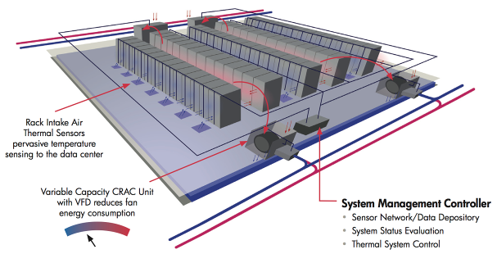
Dynamic Smart Cooling
Bridging facilities and IT to realize Adaptive Infrastructure
Energy provisioning solution can reduce cooling costs 20-45%
Standard interfaces to air-conditioning and building management systems
Easy to retrofit or spec for new construction applications
Compatible with 3rd party gear

Slide 25

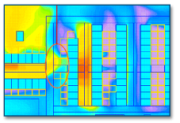
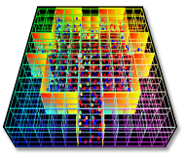
Power and cooling assessments
Thermal
Quick Assessment
Thermal Intermediate Assessment
Thermal Comprehensive Assessment
Visual inspection
Data measurements
Basic report and recommendations
Data gathering above floor modeling
Thermal modeling
Extensive report and recommendations
3D under- and above- floor modeling
Thermal prediction
Comprehensive report and recommendations
Notes:
Price of Quick Assessment is $9600
Intermediate = Price: $10K - $30K (custom)
Comprehensive = Price: $15K - $90K (custom)
HP offers customers a range of Data Center Thermal Assessment Services to help manage energy and associated cooling challenges in their data centers. Designed to help customers anticipate how their data center power and cooling needs will grow and change over time, and to assist companies in delivering innovations to realize greater efficiency in their data centers, these services include:
Thermal Quick Assessment. The Thermal Quick Assessment is an entry-level assessment of the data center power and cooling environment. A gap analysis and a written report are designed to highlight best practices and quick wins tailored for the environment and provide information to help the customer understand how to use data center power and cooling resources more efficiently. This service provides the customer with insight into the potential to achieve cooling-level objectives, be they spot adjustments or adjustment to the overall design. Thermal Quick Assessment services include onsite inspection and a formal report that includes a gap analysis based on data measurements, power usage, and hotspots.
Thermal Intermediate Assessment. This is a wider-ranging solution than the Thermal Quick Assessment and is customized to the client's needs. The Thermal Intermediate Assessment includes all the services provided in a Thermal Quick Assessment plus more sophisticated 2D thermal modeling of below-floor thermal conditions. This assessment identifies airflow patterns beneath the floor as determined by factors such as the placement of air conditioning units, the units' cooling capacity, under-floor obstructions, and perforated panel locations.
The assessment report shows countermeasures for problem areas and models "what-if" scenarios. This level of service is designed to benefit existing or proposed data centers likely to operate at or below 100 watts/sq ft.
Thermal Comprehensive Assessment. This is a customized service that includes all of the services offered in the Thermal Intermediate Assessment plus 3D modeling of the data center that provides a thermal-dynamic view. It is targeted toward data centers that plan to operate in excess of 100 watts/sq ft and toward high-density computing areas. The HP team collects temperature measurements throughout the data center and then employs modeling tools to create 3D models of specific airflows and cooling conditions in the room. The team also performs Thermal Zone Mapping, providing a view of air conditioner zones of influence throughout the data center using HP proprietary modeling software. This identifies areas that are not adequately covered, areas of overlapping coverage where the best redundancy coverage would be, and areas best suited for the addition of new equipment in the room. In addition, this assessment includes an analysis of the impact of room and rack configuration, infrastructure management practices, and failure scenarios.

Slide 26

Squeezing cost out of the energy envelope
Optimizing from chip to chiller
10 mWh
Conversion
Powering IT
35 kWh
60 kWh
Cooling
IT
Dynamic Smart Cooling
& Services
Storage & Server Consolidation
33%
Savings
Savings
3.3 mWh
Assuming a 60% savings consolidating servers, 45% savings consolidating storage and 45% remaining cooling savings from Thermal Zone Mapping & DSC together.
Notes:
The important thing to point out here is the fact that customers can experience real savings for reducing power & cooling costs
Assuming your data center uses about 100 kilowatt-hour of energy, you could reduce that by “up to” 37% savings
It’s important to make note that every data center is different and HP cannot guarantee these savings, but it shows customers where the savings opportunities are.

Slide 27
Smart Cooling Results
Potential energy savings
20%
30%
45%
Optimization
can significantly impact data center capacity
Typical
Best Practices
Static Smart Cooling
HP labs prototypes/ future
Potential capacity increases
Optimization can significantly impact
energy usage
25%
50%
85%
Typical
Best Practices
Static Smart Cooling
HP labs prototypes/ future
Malone, C., C. Belady, "Metrics to characterize Data Center & IT Equipment Energy Use," Digital Power Forum, Richardson, TX (September 2006)
or DSC

Slide 28
Optimizing Through Virtualization
Optimizing from chip to chiller
Virtualization cuts Data Center power bill by 30% to 40%.*
What Drives Savings?
What is Offers
Consolidate multiple servers at low capacity to fewer servers operating at high capacity
  Leveraging Fans, Hard Drives, Memory, and I/O
Power Supply higher efficiency at increases utilization
Even distribution of consolidated resources in data centers
ProLiant Essentials Virtual Machine Management Pack and VMware
Virtual Connect for BladeSystem
Virtual Server Environment (VSE) & Integrity Virtual Machine
Storage Virtualization with Thin Provisioning
Powering IT
Conversion
Savings
Cooling
IT
*Computerworld “Low-Cost Data Center Locations” by Robert L. Scheier, September 3, 2007 page 2.
Notes:
Virtualization provides some serious savings opportunity.
It’s important to note that this may have the single biggest impact to reduce the cost to power servers.
Don’t confuse this with the cost to Cool servers that is being reduced by DSC
This is a huge opportunity and customers should be taking advantage of this.
Examples from our Pan HP Virtualization portfolio. This is a great example of HP’s “Power of the Portfolio”
First we see in the middle HP’s Unified Management capabilities. A virtual environment needs to be well managed and simple to mange in order to achieve the best agility.
The HP Virtual Server Environment for HP Integrity servers lets you direct your server resources to your highest priority workloads automatically so you can optimize your server Utilization in real time. VSE creates an environment where virtual servers grow and shrink as business needs change. .
The ProLiant Essentials Virtual Machine Management Pack and ProLiant Essentials Server Migration Pack plug-ins extend HP Systems Insight Manager capabilities to manage virtual machines and are an important part of our Virtualization solution for ProLiant servers.
The HP StorageWorks Storage Virtualization System decreases the stress of everyday data management by minimizing the complexity of the SAN and reducing the total cost of storage ownership. The advanced Virtualization technology in the SVS200 simplifies data migration, volume management, and data replication in SAN environments all of which can be managed from one single pane of glass.
The HP Virtual Connect architecture for HP BladeSystem lets you cleanly separate the management of server enclosures from LAN and SAN management. It lets you Add, move, and replace servers in minutes without affecting your LANs or SANs, providing flexibility for the server administrator and relieving SAN and LAN administrators of the need to follow the moving server.
Because we’re using Virtualization we can move things around and adjust resources based on changing workloads or demands, we can improve operational availability of a service or application…so customers can also use virtualization as foundational element in a Business Continuity & Availability solution
Thin Provisioning is an over-provisioning scenario. That is, you want a 2TB file system, but only allocate 1TB of physical space. The file system believes it has the full 2TB to work with. Or maybe you want 10 different 2TB file systems (20TB total) and only alloace 10TB for all of them. What happens when you need some more space? It depends. Some implementations let you "borrow" space from another location. The obvious answer is to grow the physical LUNs (or add a new one) to provide the required space.
Dynamic Capacity manager actually works with the Microsoft (only) operating system to automatically migrate storage capacity where it’s needed.
EVA Dynamic Capacity Management:
Improves disk utilization improves power efficiency
Raises capacity utilization efficiency by up to 2X
Saves up to 45% on power
XP Thin Provisioning:
Reduce cost and save power by up to 40% 1 – customer only buys what it needs today
Automatically allocates physical capacity

Slide 29


Gaining efficiency
Element virtualization solutions to pool and share
resources from desktop to datacenter
Server consolidation
50-100+% increase in utilization
Storage consolidation
50-100% increase in utilization
Unvirtualized servers
HP server running
virtualization software
(e.g., VMware, Microsoft Virtual Server, Xen, HP Integrity Virtual Machines)
15 TB
DAS to SAN –
6TB less
Raw Capacity TB Purchased
9 TB
Virtualization –3TB less
DNS/DHCP
6 TB
Print server
4.5 TB
Utilized
4.5 TB
Utilized
4.5 TB
Utilized
ERP
DNS/DHCP
Print server
ERP
Custom apps
Web server
NT apps
Database
And more
Individual servers with DAS
SAN
HP StorageWorks EVA in a SAN
Custom apps
Utilization
30%
50%
75%

Slide 30

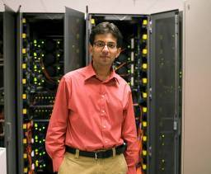

Approach to energy innovation
Leverage energy-efficient products
Improve energy efficiency of operations
Rethink energy use to transform society
Energy efficient
Energy effective

Slide 31
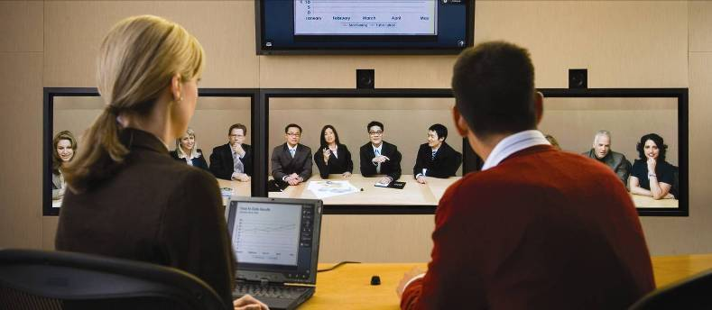
Using technology to minimize travel
Halo Collaboration Studio simulates
face-to-face meetings, enabling interactive collaboration while avoiding CO₂ emissions.

Slide 32
Meeting global eco-label standards
EPEAT Gold Awards, www.epeat.org
ENERGY STAR^{® 4.0}
Taiwan Green Mark
Japan PC Green Label
China Energy Conservation Program (CECP)
IT Eco Declaration
TCO ’03 (Sweden)
Korea Eco-Label
Environmental Choice (Canada)

Slide 33
Mega Considerations for Green IT
Energy Efficiency
ENERGY EFFICIENCY
Material Impact

Slide 34

Material Impact
Growth of IT Waste
Design for Environment
Recycling Products
Refresh and Renew Products
Packaging

Slide 35

Example of a small counties eWaste program
2002: 16.5 Tons
2003: 29.5 Tons
2004: 169.7 Tons
2005: 187.3 Tons
2006: 290.1 Tons
2007: 346.4 Tons

Slide 36
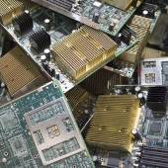

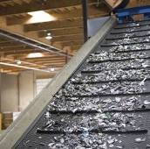
Design for Recycling
Use modular designs
Eliminate glues and adhesives
Mark plastic parts
Reduce number/ types of materials used
Use single-plastic polymers
Use molded-in colors and finishes

Slide 37
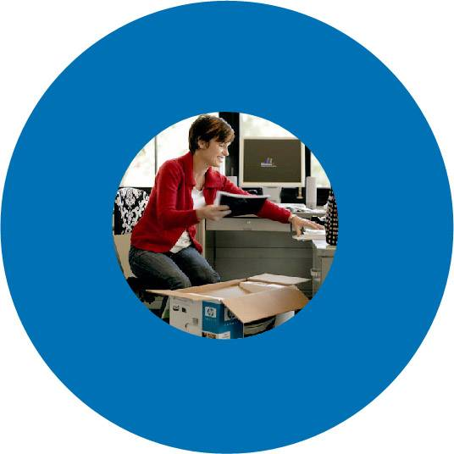
Illustration of Environmental Impact through a Product Life Cycle
Product
Design
Revise
Strategy
Manu-
facture
Evaluation
Use
Reuse
and
Recycle

Slide 38
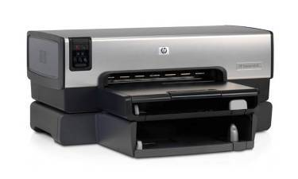
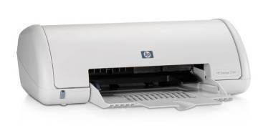
Easy-to-recycle products
No-paint, snap-fit design for easy disassembly—Deskjet 6540
Shares common parts—Deskjet 3740
Reduced number of parts—monochrome HP LaserJet print cartridges

Slide 39
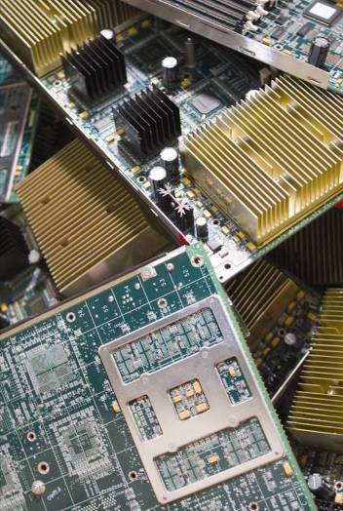
Product reuse and recycling options
Trade-in
Return for cash
Leasing
Donation
Recycling
Asset recovery
Remarket/refurbish

Slide 40
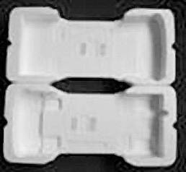
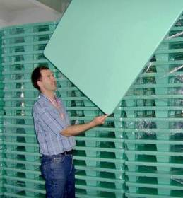
Smart packaging
Use molded pulp with recycled material
Switch from wood to foam plastic pallets
Simplify documentation and CDs in boxes
Package PCs together

Slide 41
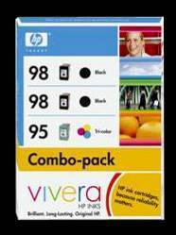
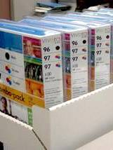
Case study: inkjet packaging
New packaging equals:
2,813 cars off the road
1.48 million gallons of gasoline saved
1,668 American homes powered
107 acres of forest preserved
4,375 tons of landfill waste avoided

Slide 42
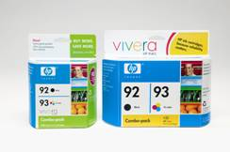
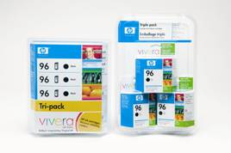
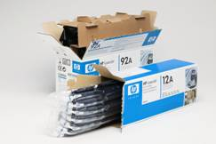
Redesigned Ink and Toner Cartridge Packaging to Reduce Greenhouse gas emissions by 37 million pounds in 2007.
Old
New
New Old
40% less packaging
New Old
40% less packaging
45% less packaging
  HP Press Release February 8, 2007

Slide 43
  This year, we have surpassed our goal of recycling 1 billion pounds of electronic products and supplies

Slide 44
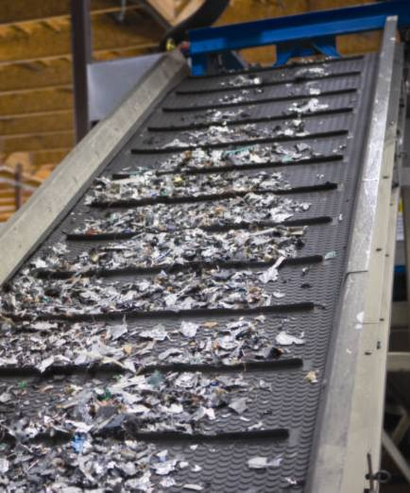
A look at a recycling facility
HP’s U.S. plants process 1.5 million pounds of electronics a month.
HP recovers 8 to 10 ounces of precious metals per ton of recycled materials.

Slide 45
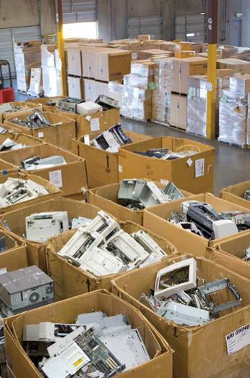
HP’s recycling accomplishments
More than 164 million pounds recycled globally
10.4 million pounds of plastics
2.4 million units
10 percent of relevant sales

Slide 46
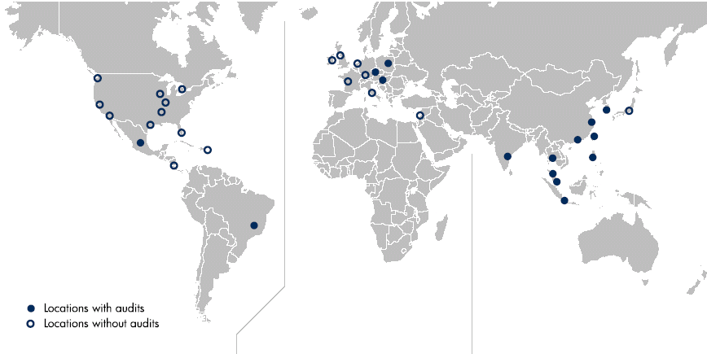
Extending HP social and environmental responsibility policies to HP suppliers
Major locations of HP product materials, components and services suppliers
Americas
20% of total spend
Europe, Middle East and Africa
5% of total spend
Asia Pacific and Japan
75% of total spend
Notes:
HP has one of the largest and most complex supply chains in the IT sector.
We purchase materials and components as well as manufacturing and distribution services from suppliers located all over the world.
These suppliers have more than 1,000 manufacturing sites worldwide.
HP is conducting supplier audits in the Asia Pacific and Japan region, China, Latin America and Central Europe.

Slide 47
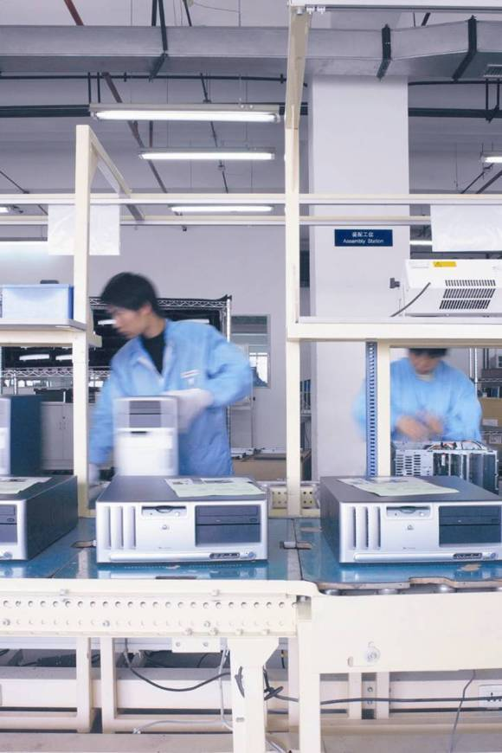
We review and audit our suppliers
In 2006, HP had audited 115 direct material suppliers at 254 sites.
In 2007, HP audited an additional 45 suppliers and follow up at 100 sites.
Our suppliers must meet strict requirements regarding human rights, labor, health and safety, environment and ethics.
Notes:
HP conducts regular supplier audits and site visits to ensure alignment with our environmental, occupational, health and safety, labor and human rights, and ethics standards.
Suppliers must demonstrate progress in a reasonable amount of time, and depending on the seriousness of a code violation, suppliers can and will be terminated.
In 2006, we introduced new programs to train suppliers in processes to meet our standards.
We prioritize suppliers for review, self-assessment, audits and capability-building programs based on risk categories including location, process, relationships and company information. We then focus on high-risk suppliers.
By the end of 2006, we had introduced our supplier SER program to 557 suppliers. Of those, 445 had completed self-assessments and 115 had been audited at 254 sites in Brazil, China, Czech Republic, Hungary, India, Indonesia, Korea, Malaysia, Mexico, Philippines, Poland, Singapore, Taiwan and Thailand.
In 2007, our goal is to audit an additional 45 suppliers and conduct new and follow-up verification audits at 100 sites.
HP plays a lead role in the Europe-based Global e-Sustainability Initiative and the Global Monitoring Standards Project, which are developing a global certification process for supply-chain auditors.
Suppliers must complete detailed, factory-level assessments and audits on labor practices, health and safety, environment, ethics and management systems to ensure conformity to our code.
We require that all suppliers comply with all local, regional, national and international laws. This is non-negotiable for HP and every supplier must demonstrate knowledge and compliance.

Slide 48
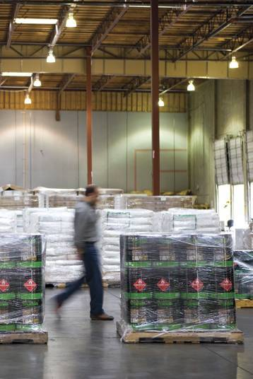
Aggressive environmental goals
Restrict materials
Reduce fuel use in transportation
Design environmentally responsible packaging
Reduce energy consumption
Notes:
One of our long-term commitments is to help our suppliers reduce their environmental footprint.
Suppliers must have policies covering energy efficiency, hazardous materials, information and labeling, manufacturing, packaging, and product recycling.
HP reduces the environmental impact of our own and our suppliers’ products through design, sourcing of raw materials, manufacturing, distribution, use and product end-of-life.
Materials: HP suppliers sign contracts committing them to the Electronic Industry Code of Conduct (EICC) and HP’s General Specification for the Environment (GSE), which restricts materials that can be used in HP products. Legislation regarding hazardous substance restrictions, such as the EU Restriction of Hazardous Substances (RoHS) directive, has also required us to substitute materials.
Transportation: HP works with suppliers through the Clean Cargo Group and Green Freight Group to enhance overall environmental performance of the transportation industry. Over the past decade, HP has decreased reliance on air transportation services and increased use of ocean freight.
Packaging: HP implements efficient packaging and logistics to decrease cost, fuel consumption and impact.
Energy consumption: HP works with suppliers to achieve energy consumption goals that reduce impact during use.

Slide 49

Next steps to a Green IT Transformation
Reduce overall energy with IT products, data center best practices
Leverage conversations between IT and facility management
Evaluate waste programs both internal to your organization and with the public
Purchase renewable energy
Implement Workplace Transformation -Change mentality about energy, environment, and the collateral benefits of Green IT

Slide 50


Questions
Brad Dupuy
Brad.dupuy@hp.com
281 927 9347

Slide 51
Thank you

Slide 52
HP’s environmental leadership
No. 8 on the list of 100 Greenest Companies, 2007
—Newsweek
Top 10 Fortune Green Giants list, 2007
—Fortune
Top 10 Green Companies of 2006 list
—Portfolio 21

Slide 53














HP Environmental awards and recognitions
Recycling Council of British Columbia Private Sector Recognition Award
Design for Recycling Award from Institute of Scrap Recycling Industries
Named to Fortune magazine’s list of
10 Green Giants
PRMA Award for Environmental Performance at HP Aguadilla facility
Ranked 8th on list of the 100 Greenest Companies
Named to Top 10 Green Companies List
Achievement Awards, National Performance Track and Green Power Partners
Association Agency Brazil de Segurança Award of Environment
2006 and 2007 Environmental Printing Award from PrintAction
Washington State Recycling Association Recycler of the Year
Corporate Leadership Award from Recycling Council of Alberta
Winner of Best Sustainability Report Award for Global Citizenship Report in 2005 and 2006
2007 AF&PA Business Leadership Recycling Award from American Forest & Paper Association
Recycling Council of Ontario Platinum Waste Minimization Award
Demand Response Award in California Flex Your Power Program
Honorable Mention in Mexico’s SEMARNAT Ecological Merit Award

Slide 54
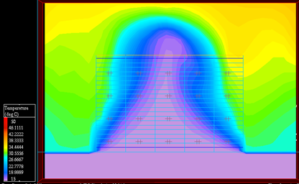


Thermal modeling because it is not always intuitive
95% open vent tile results in
hotter inlet air temperature
95% open tile
5% open vent tile results in cooler inlet temperature
Front View
5% open tile
Front View
Notes:
This shows how amount of opening within a vented floor tile affects the airflow in a way that’s not intuitive.
Explain that in order to address the top-left hotspot a customer may use a more open tile in order to get more air flowing up in front of the server. However, the larger opening means that the air is easily dissipated before it reached the top of the rack. The correct thing to do is use a smaller hole, which created more pressure and blows the air up to the top of the rack.
Because most DCs are complex places with varying configurations the only way you will build a full understanding of how your cool air is being used is to build models. Then you can start to make some intelligent decisions about what needs to go where to make the most effective and efficient use of the cool air you are spending money to produce.

Slide 55





HP Data Center Cooling Solutions
Investment for bigger savings
Data Center Design Consulting
Dynamic Smart
Cooling
Thermal Comprehensive
with Thermal Zone Mapping
Thermal Intermediate
Investment for quick wins
Thermal Quick
Best practices consultation
Customized analysis
and consultation
Real-time rebalancing
Notes:
Thermal Assessment Services help you move toward a highly efficient data center.
we offer innovative thermal assessment services. These services leverage sophisticated modeling tools and techniques to determine the unique thermal conditions for your high-density server and storage equipment. The information generated by thermodynamic modeling helps you understand what you need to do to improve the efficiency of your data center and gain more value from your energy expenditures.
HP offers three Power and Cooling thermal assessment services – ‘Quick, Intermediate and Comprehensive’ – that combine HP’s leading power and cooling technology, lab research and expertise to help companies achieve greater efficiency and cost savings in their data centers. The comprehensive assessment now includes thermal zone mapping. This industry-first capability provides a multi-colored 3D graphical thermal map of the entire data center to help IT identify air flows and mixing patterns and identify opportunities to adjust Computer Room Air Conditioning (CRAC) output settings for energy savings and efficiency.
Leveraging the assessment and Thermal Zone Mapping data, HP Services can help IT develop and implement sustainable energy-efficient strategies that allow them to cut power consumption and reduce environmental impacts across the environment, while increasing capacity and performance. Armed with this accurate and solid data, a CIO can use this information to understand the thermal characteristics of a data center:Identify overlapping regions of cooling capacity. This is useful in showing locations in the data center where high density and/or mission critical equipment could be placed for optimal cooling; Analyze “what-if?” scenario changes in the data center such as room layout or infrastructure changes, cooling capacity changes, or failures; and Ensure that a proper cooling solution has been achieved. Using the data and analysis from the assessment and the Thermal Zone Mapping, CIOs can create a strategic roadmap to optimize the data center such that they can:
Save money - Energy and cooling costs can be reduced by as much as 45 percent when combined with HP Dynamic Smart Cooling without sacrificing performance;
Increase capacity - More equipment can be added to an existing data center, avoiding or postponing the need to build a new data center;
Improve reliability - Future failures can be mitigated by reducing overheating risks, ensuring that a proper cooling solution has been achieved.

Slide 56



HP’s approach to energy innovation
Design energy-efficient products
Improve energy efficiency of customer processes
Rethink energy use to transform society
Energy efficient
Energy effective
Notes:
We can achieve energy innovation at three different levels.
At the most basic level, it’s important to make products and components more energy efficient.
HP sets ongoing design targets for our products, from PCs and printers to servers.
However, that’s just the first step in the process. HP’s leadership in energy innovation really shines in developing technology solutions to improve our customers’ processes.
HP Dynamic Smart Cooling energy management system is designed to deliver 20 percent to 45 percent savings in cooling energy costs or will allow additional equipment to be added to the data center and still keep net power costs constant.
When we take it a step further, we can help transform society to make our entire lives more energy effective.
HP’s Halo Virtual Collaboration System simulates face-to-face meetings, enabling us to work collaboratively while reducing our business travel and avoiding CO₂ emissions. We currently have 26 Halo Studio locations at HP sites.
HP also works with customers to reduce their environmental footprint, by helping them set up Halo VCS systems. Employees travel less and can get more work done, as well as increase the quality of their lives by having more time to spend with family and at home.
HP offers a competitive advantage because of the value that comes from integrating energy-efficient products into energy-effective services.
Operations
In the global context, HP’s emissions are small: about 1.5 million metric tons of CO₂ compared with the worldwide emissions of 25,000 million metric tons.
HP believes a company’s performance measurement and transparency are important to our industry’s response to climate change because they lead to greater accountability. In 2003, HP was one of the first companies to commit to the World Economic Forum’s (WEF) Global Greenhouse Gas Register, whose signatories account for nearly 5 percent of global GHG emissions.
We measure and verify our greenhouse gas impacts from fossil fuel and electricity consumption.
HP is reducing overall energy use, implementing energy-efficient projects that saved more than 27 million kilowatt-hours in 2006 alone.
We have committed to purchasing 25 million kilowatt-hours of green power from renewable sources in 2007.
Worldwide we have 11,400 employees who work exclusively from their home offices. We estimate that in 2005, the Telework program saved more than 2 million round-trip commutes in the United States and Canada, avoiding about 57 million miles of road travel and reducing GHG emissions by more than 24,000 metric tonnes of CO₂. More than 2,300 employees outside of the United States and Canada are telecommuters.
Using Halo Virtual Collaboration System and other technologies, HP has reduced business travel.
We have a goal to reduce energy consumption and the resulting carbon dioxide emissions from HP-owned and HP-leased facilities worldwide to 15% below 2006 levels.
Product energy efficiency
HP develops products that use energy efficiently to help customers save money and reduce environmental impact.
We set some aggressive goals for 2010:
Reduce the combined energy consumption of HP operations and products 20% below 2005 levels by 2010
Improve energy efficiency for high volume server families by 50%, relative to 2005 .
Improve energy efficiency for high volume printer families by 30%, relative to 2005 .
WWF partnership
HP is collaborating with the World Wildlife Fund to reduce greenhouse gas emissions from our operating facilities worldwide, educate and inspire others to adopt best practices, and use HP technology in conservation efforts around the world.
We will report and verify carbon dioxide emissions from our facilities, based on the Greenhouse Gas Protocol and the World Economic Forum’s Global Greenhouse Gas Registry.
We will develop energy efficiency measurements for our product categories. Based on those metrics, HP will work with WWF to develop goals for improved product performance and report publicly on progress toward those goals.
WWF and HP will define and implement educational efforts to address climate change with key stakeholders and highlight best practices adopted by consumers and businesses.
WWF and HP will leverage HP technology to advance the science and practice of adapting and becoming resilient to climate change. An initial project involves funding from HP to study the effects of climate change on the wildlife and habitats of North America’s Bering Sea.
HP has set a goal to reduce the combined energy consumption of our operations and products by 20% by 2010. We also set energy efficiency goals for several product segments (see Goals for further explanation). Achieving these goals is part of our strategy to be an industry leader in energy efficiency.

Slide 57
Smart Cooling Solutions
HP delivers three Smart Cooling Solutions
HP Thermal
Quick
Assessment
HP Thermal Intermediate Assessment
HP Thermal Comprehensive Assessment
Visual inspection
Data measurements
Basic report and recommendations
Data gathering
Thermal modeling
Extensive report and recommendations
3D under- and above- floor modeling
Thermal prediction
Comprehensive report and recommendations
Notes:
Price of Quick Assessment is $9600
Intermediate = Price: $10K - $30K (custom)
Comprehensive = Price: $15K - $90K (custom)
Examples of reports can be shown at this point

Slide 58


HP Thermal Quick Assessment
What it is
Visual inspection, data analysis and written report of findings
Based on interviews with staff and HP observations and measurements within the data center

Slide 59
HP Thermal Quick Assessment (cont.)
What it does
Provides basic understanding of power and cooling capability to support high-density data center environments
Recommendations and best practices to improve cooling efficiency
Allows smaller scale investment for quick wins and longer-term improvements
Cold aisle
Hot aisle
Raised floor
Front
Front
Front
Equipment rack
Vented tile
Non-vented tile

Slide 60


HP Intermediate and Comprehensive Thermal Assessments
What it is
Visual inspection, extensive data gathering and analysis, recommendations for short and long-term improvements
HP thermal modeling technique using a scientific approach to airflow and temperature predictions

Slide 61

HP Intermediate and Comprehensive Thermal Assessments (cont.)
What it does
Sophisticated modeling tools provide data on the unique thermal conditions in a
data center
Shows the impact of
different rack configurations, infrastructure management practices, and recommended cooling efficiency measures
Supply heat index
.36
.38
CRAC
unit A
.11
.36
.10
.40
.13
.19
CRAC
unit B
CRAC
unit C
CRAC
unit D
Y
Z
X

Slide 62
Assessment, planning and relocation
Data Center
Assessment
Data Center
Planning
Data Center
Relocation
Analysis of infrastructure with detailed report
Explanation of risks, deficiencies and recommendations
Comprehensive site-preparation audit to successfully integrate new equipment
In-depth reporting of any deficiencies, including floor-plan drawings locating equipment, receptacles, airflow panels, cable cut-outs, etc.
Available for single
or multiple systems, entire data centers,
or multiple data center consolidation
Project management and move coordination
Notes:
In addition to its Smart Cooling Offerings, HP offers these other Data Center Services to address the full spectrum of customer needs.
Data Center Planning includes: verification of installation and service space, examination of the capacity and availability of power distribution, cooling, and airflow distribution systems, and review of installation readiness prerequisites
Data Center Relocation: Comprehensive services for moving technology products within your business — on a local, national, or international basis. We can shoulder responsibility as your single point of contact. Products supported include HP servers, workstations, desktop systems, notebook PCs, thin clients, storage devices, and networking and software products, as well as HP-supported hardware and software from other vendors. Resources include:
IT consolidation planning
Application & data migration consultancy
Server vitalization solution implementation
De-install and re-install server, storage and networking components
Move of desktop infrastructure associated with data centers
Data Center Services Data Sheet: http://source.hp.com/go/5982-0094*
HP.com: www.hp.com/services/datacenterservices

Slide 63
More on:
Data Center Assessment Services
Provide a thorough review and analysis of the facility’s infrastructure
Based on industry standards and best practices
If risks or deficiencies are found, HP provides prioritized recommendations on how to remedy
Findings are documented in a detailed report
There are standard and optional components to this customizable service:
Standard
Optional
Space
Power
Cooling
Raised floor
Shutdown controls
Fire protection
Engine generator
EMI
Environmental monitoring
Earthquake threat
Power quality
Maintenance
High-frequency noise
Sound levels

Slide 64
More on:
Data Center Planning Services
Comprehensive site-preparation audit that helps successfully integrate new equipment into a facility
An in-depth report identifies any deficiencies and provides floor-plan drawings locating equipment, receptacles, airflow panels, cable cut-outs
Service deliverables include:
Verification of installation and service space
Examination of the capacity and availability of power distribution system
Analysis of cooling system capacity and airflow distribution
Review of installation readiness prerequisites

Slide 65



More on:
Data Center Relocation Services
What is it?
What products are supported?
A comprehensive set of offerings customized to meet your unique requirements for moving technologies in your business with minimum business disruption
HP servers, workstations, desktop systems, notebook PCs, thin clients, storage devices, networking and software products, as well as
HP-supported hardware and software from other vendors
Move heterogeneous systems, data centers or entire facilities
Consolidate data centers; open/close facilities

Slide 66

Smart Cooling – how does it work?

Slide 67

Old thinking…
The average data centered is
designed for 75 – 100 watts per
square foot or 800 – 1100 watts
per square meter
A few data centers are designed for 150 watts per square foot or 1615 watts per square meter
If every rack were equal in a data center operating at 100 W/sq.ft., each rack’s load would be 3.5 kW/rack, maximum
A full rack of 1U servers or Blades ranges from 9 kW to 22 kW per rack
Simple math says a data center can’t support rack loads in excess of 3.5 kW/rack

Slide 68

New thinking…
Data center design metric used to
determine overall capacity NOT
how much power can be delivered
to a single rack
Loads are never balanced in a data center, some locations are low and others are high…W/sq.ft. merely describes the average
A 100 W/sq.ft. data center can support a 12 kW rack…just not several of them in a row
The trick is effective delivery of cooling resources to the required rack location

Slide 69


Static Smart Cooling: Thermal Modeling
What is it?
An HP-developed approach to effective thermal management and energy efficiency
Uses sophisticated modeling tools and techniques to understand the unique thermal conditions in a data center.
For example, modeling will show if there is any recirculation of the warm exhausted air from the servers back to the intake of the servers.
Region Size
100 % load
Modeling can show the impact of:
  High-density racks mixed with low density racks
  High-density racks on cooling resources
  Improvements to infrastructure management practices
  Air conditioner failure or shutdown for
  scheduled maintenance
50% load

Slide 70


HP Smart Cooling: before and after
Before
Uniform 150 W/ft² cooling
After
Repositioning inlet air vents
The only degree of freedom
AC (5X)
Hot Aisle
Hot Aisle
Cold Aisle
Cold Aisle
Hot Aisle
Hot Aisle
Cold Aisle
Cold Aisle
Hot Aisle
Hot Aisle
Cold Aisle
50% population 8-10 kW racks
Cold Aisle
Cold Aisle
Hot Aisle
Cold Aisle
Cold Aisle
Hot Aisle
Cold Aisle
Window
Source: Chandrakant Patel, HP
Notes:
Before:
Hot aisles should be red and cold aisles should be blue
Area in bottom left should have been cold, but was heating up
After:
Much more well-balanced temperatures

Slide 71



Above floor thermal map
Comprehensive Assessment Software Plot
Y-Plot at 78” from the raised floor
Cold Aisle
Cold Aisle
Cold Aisle
Cold Aisle
Cold Aisle
Max. inlet temperature occurs at R9C1: 84.1ºF
R9C1
R10C1
Notes:
Here we have a well planned data center with equipment in hot and cold aisles. The racks load vary like they do in any data center. The key here is that some very high-density racks (30kW) are scattered around the room to see if a typical data center could support such loads. The bright red spots (upper left, center, and lower right corner) represent the exhaust from these high-density racks.
There are three high-density racks side-by-side in the lower right corner. Notice how the heat curves around the corner of the room and flows into the nearest cold aisle. This view is 78 inches above the floor or just a few inches below the top of our racks. The black dashed oval shows heat entering the top servers of the first rack. The image to the lower left is an exploded view of the dashed oval. It is very difficult to characterize this airflow using intuition but very easy with CFD tools.
Several recommendations can be made from this model.
Don't locate high-density equipment at the end of a row, even though intuition might suggest placing it as close to an air-conditioner as possible.
Don't group high-density loads together unless you are certain the room can support that configuration; i.e.; distributing high-density loads is a very effective solution when integrating high-density loads in a low-density data center.
Locate the high-density loads in the middle of a row. You will get more air out of the floor at this point and the heat will travel back to multiple air-conditioners (in many but not all cases).

Slide 72



Thermal elevation views
Inlet air temperature at Row 9 / Row 10 inlets
R9C1=84.1ºF
R10C1=82ºF
R9C3
R10C3
R10C1
R9C1
Front View
Side View
R9C1=84.7ºF
CRAC
R9C1
R10C1
Notes:
This slide is an extension of the previous slide. They present elevation views (floor to ceiling) of the same area surrounding the black dashed oval on the previous slide.
The labels on the racks, such as; R9C1 means Row 9 Cabinet 1
The solid blue rectangle on the right side of the upper two images represents an air-conditioner
The bright red area in the upper right corner of each image represents the intense heat from the three high-density racks (R10C1 – R10C3) getting trapped in the corner of the room and against the ceiling. Some of the heat returns to the top of the air-conditioner (where it should) but some migrates towards Rack R9C1.
The intent of these images is to show that heat can infiltrate cold aisles and in this case the inlet air temperature entering the servers near the top of R9C1 exceed our preferred threshold of 77F.

Slide 73








Future service: Dynamic Smart Cooling
What it is
Distributed sensor network attached to standard racks for direct measurement of the environment
Dynamically controls cooling based on real-time monitoring of the sensors
Announced Nov 29, 2006; available late 2007
Notes:
CRAC = Computer Room Air Conditioning
The next generation of data center design revolves around an energy efficient, fully automated and adaptive design that automatically react to the changes in compute and cooling load, adjusting itself automatically to compensate for increases or reductions that may occur at any given point of time. The data center will have the ability to “sense” and “react” to the changes via a sensor network and control software that will command the various systems to ramp up or ramp down accordingly.
Applied to the cooling infrastructure, the controller will process the data input from the sensor network deployed across the data center and command the CRAC units to increase or decrease the CRAC air handling unit fan speed accordingly to adjust the cooling air supplied to a particular area.

Slide 74

Future service: Dynamic Smart Cooling
What it does
Thermal sensing at rack level, signals the software to rebalance cooling
Manages energy consumption by controlling air conditioning units and supplying cooling dynamically
Up to 50% savings in cooling costs, experimental data from HP Labs
Blower speed controller
Sensor and control network
Variable capacity CRAC unit
Rack intake air thermal sensors
System management controller
Sensor network/data depository
System status evaluation
Thermal system control

Slide 75
Dynamic Smart Cooling Elements
Core elements:
Management Software
Calculation/commissioning sensor placement
System status/monitoring
Auto-balancing cooling resources
Deployment Service
Site readiness and design – assessment, mapping, sensor placement plan
Installation – sensors, mgmt console, software, commissioning
Hardware
Rack Sensors
Management console
Variable Speed Fan Kit (not provided by HP)
Warranty
Hardware
Software
Additional Services (purchased separately, select at least one)
Maintenance contract (various coverage/ response time levels available)
Ongoing performance optimization

